Slide 1
A Presentation on Product Review Analysis Project Planning Report at
 | 1. Problem Statement 2. Tools Used 3. Approaches 4. EDA Insights 5. Best ML Model 6. Evaluation Metrics of Model 7. Future Development

Slide 2
1.Problem Statement
Customer reviews & feedback are crucial for any product in the market. Product reviews & feedback from customers play a pivotal role in enriching the product's quality & alongside meet the market expectations. It is easy for any seller to get reviews through one-one conversations with customers if the product is sold in offline stores, but it is difficult to retrieve & analyse the same reviews if the same product is sold online
E-commerce is one of the booming industries & is a one-stop destination for various sellers to market & sell their products online to attract a larger market. Given a set of customer reviews of each category (camera, battery, display, value for money, performance) for a mobile that is live on an e-commerce platform like (Flipkart/Amazon. etc):
1) Categorize & analyse the reviews to calculate the percentage of positive & negative reviews.
2) Calculate the total rating on a scale of 5 for each category.
3)Create a Ranking table for each Mobile phone based on each category and overall ranking.
e same reviews if the same product is sold online

Slide 3
2. Tools Used
1.Python
2.Pandas
3.Numpy
4.Matplotlib
5.Seaborn
6.Plotly
7.Sckit-Learn
8.Gensim
9.NLTK

Slide 4
3. Approaches
1.Import Data
2.Clean Data
3.Word Tokenization
4.Stop Word Removal
5.Lemmatization
6.Sentimentanalyser
7.Doc2vectorization
8.TFIDF
9.Split Data
10.Model Building
11.Model Testing

Slide 5
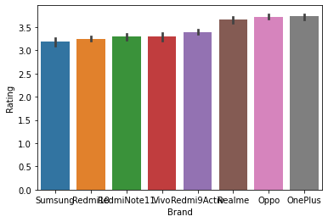
4. EDA Insights
.

Slide 6
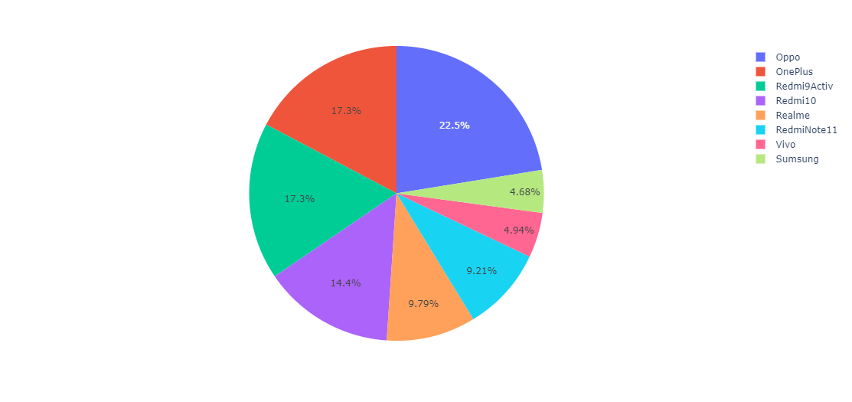
Five Star Rated Phones

Slide 7
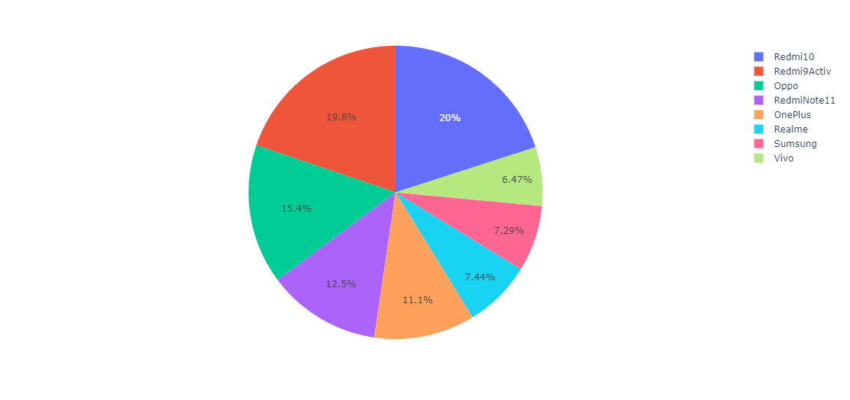
One Star Rated Phone

Slide 8
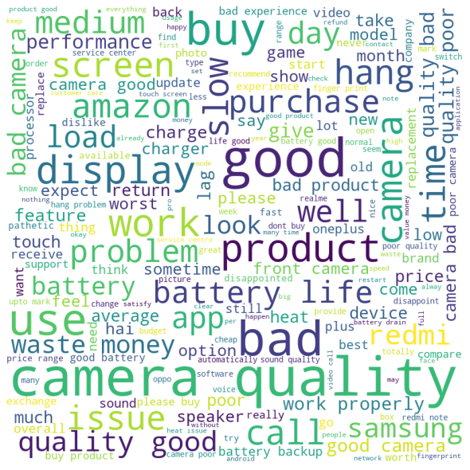

Worldcould

Slide 9
5. Best ML Model
XGB Classification is best ML model

Slide 10
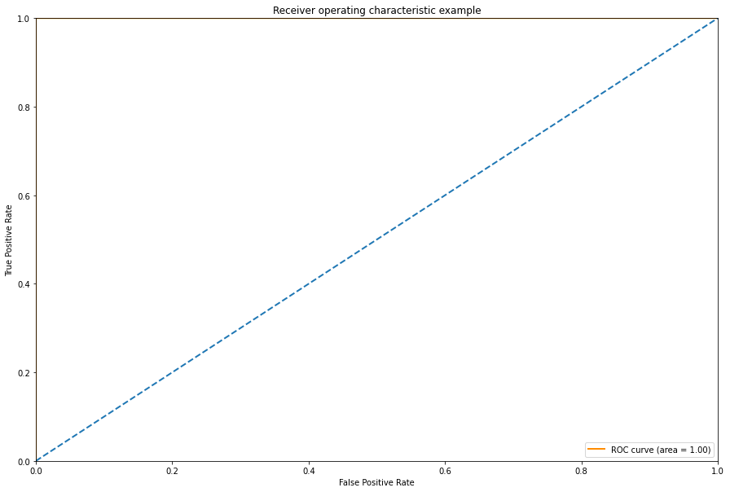
6. Evaluation Metrics of Model

Slide 11
7. Future Development

Slide 12
Conclusion
.

